Slide 1

Welcome…..

Slide 2

The problem
Hospitals all around the globe are being flooded with patients as the COVID-19 virus has spread.
Doctors are being left with no other choice but to close down their private chambers.
Rural areas have become deprived of healthcare facilities
A severe scarcity in oxygen, plasma and other quintessential nuances is seen due to the overflow of the patients.
Due to the lack of access of proper information, people have fallen prey to misinformation and rumours.

Slide 3
Our Innovation
Availing emergency healthcare facilities at one’s doorsteps.
Providing plasma, covid tips, emergency ambulance services, 24/7 online pharmacy facilities etc).
Volunteer services for the rural areas so that the rural people can access healthcare facilities with ease.
Appointments with renowned doctors according to one’s convenience.
Making use of USSD on posters so that people can access healthcare facilities even if they don’t have a net connection.

Slide 4
Our Services
Covid Essentials
E-Pharma
Doctor Search
Ambulance Services
Emergency Care
Health Blog
Health Tips

Slide 5
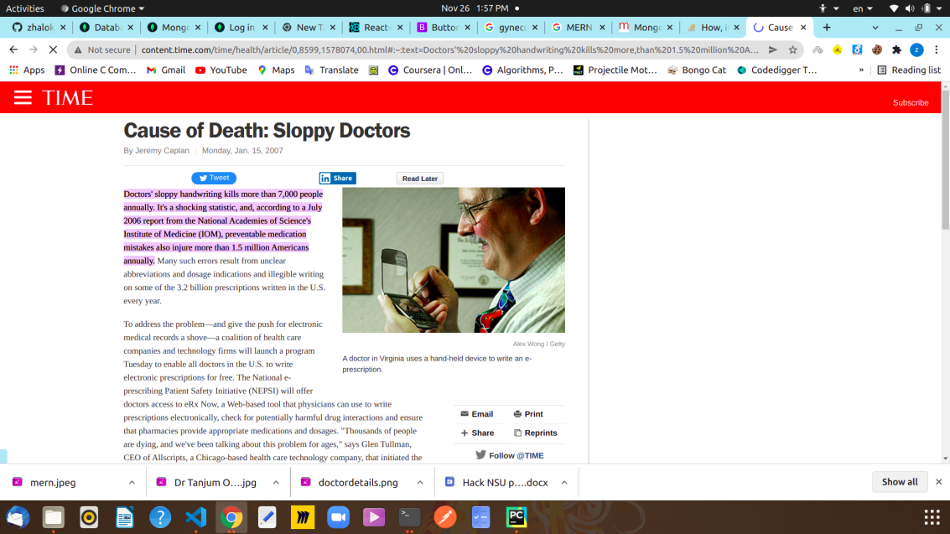
Doctor Search
Searching qualified doctors according to one’s requisites
Scheduling appointment and meeting through video conferences.
Automated prescription and pdf version. The inscrutable handwriting of doctors have proved to be really lethal during the treatment of the patient.

Slide 6
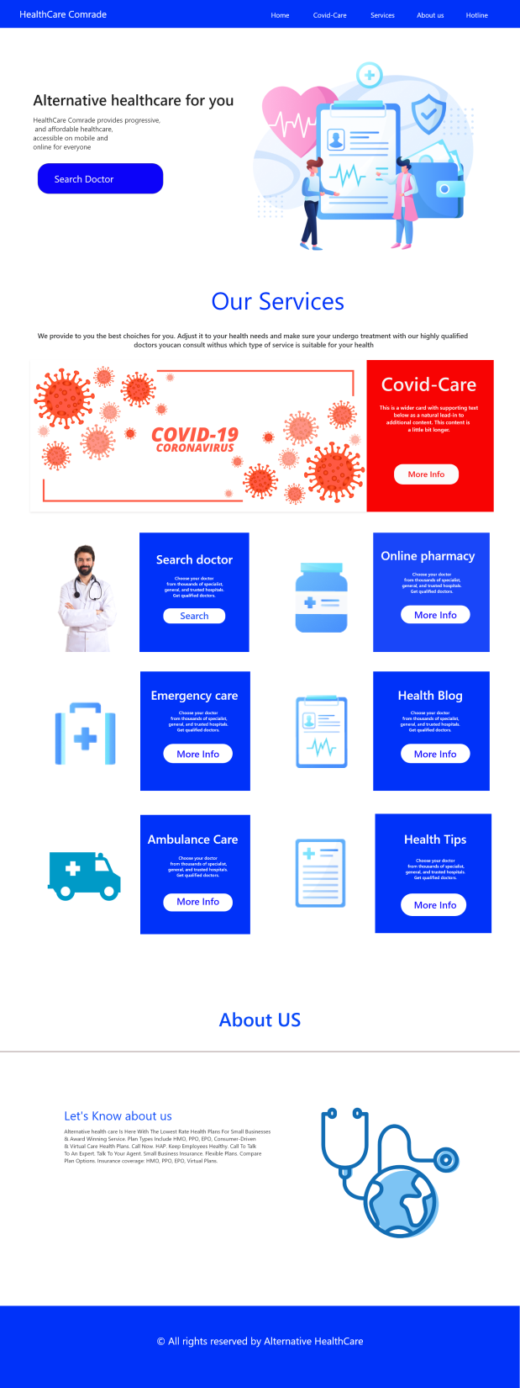

Slide 7
E-Pharma
This feature is really intriguing and life saving too! One can get info about the nearby pharmacies while looking for a particular medicine. One can also get hold of alternative medicines. For instance, if someone needs Napa and it’s unavailable in the nearby pharmacies, then the doctor would suggest some alternative medications like Ace. Also the volunteers can deliver the medicines at the doorsteps under dire circumstances.
Covid Essentials
Patients would be notified about the whereabouts of plasma, oxygen and other emergency supplies. Moreover, the volunteers would also come forth to deliver those at your doorsteps.
Health Tips:
To avoid being engulfed in rumours. it’s crucial to be on alert and here the health tips play important role.

Slide 8
Voluntary services and campaigning
The voluntary services is mainly associated with the incorporation of USSD in posters along with campaigning in the rural regions. The use of USSD is a mighty game changer as using this would direct anyone(even if s/he doesn’t have an account) to the webpage. And when someone uses the USSD, their information would be conveyed to the volunteer team .

Slide 9
Marketing Plan
Our marketing can be portrayed as a strategic approach to minimal costing. As the doctors are getting referred through the web, they would be charged 10% of their total fees and we would be using that money for the future purposes. It must be also mentioned that we this idea has a lot of potential and its truly scintillating; we can’t expect good quality if we are always looking for cheap measures. Therefore, we would be looking for sponsorship along with other funds to implement our plans fully.

Slide 10
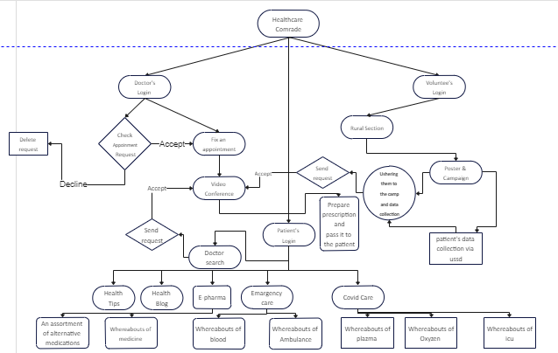
System Architecture

